Slide 1
UNIVERSITY INSTITUTE OF COMPUTING
Bachelors of Computer Applications
Minor Project
21CAI-319
Real Time Face And Eye Detection Using Machine Learning Algorithm
An Overview
of Computing
&
Career Planning
Student Name: Rahul Saini
UID: 21BCA1953
Section/Group:
Supervisor Name:
Employee Code:
Designation: CU
Major Project Presentation
DISCOVER . LEARN . EMPOWER

Slide 2
Presentation Outline
Introduction to Project
Technology Used
Objectives
Overview Of Machine learning
Face Detection
Eye Detection
Real Time Face and Eye detection
Real Time Implementation
Conclusion & Future Aspects
Note: In Conclusion kindly mention Software Model used & Project Cost

Slide 3
Introduction to Project
Machine learning is a branch of artificial intelligence (AI) and computer science which focuses on the use of data and algorithms to imitate the way that humans learn, gradually improving its accuracy.
OpenCV is an open-source computer vision library that uses machine learning algorithms for face detection, object tracking or colors detection. we’ll learn how to use the Haar Cascade algorithm to detect faces and eyes in real-time video

Slide 4

Technology Used
OpenCV-Python
Machine learning
Haar cascade algorithm

Slide 5
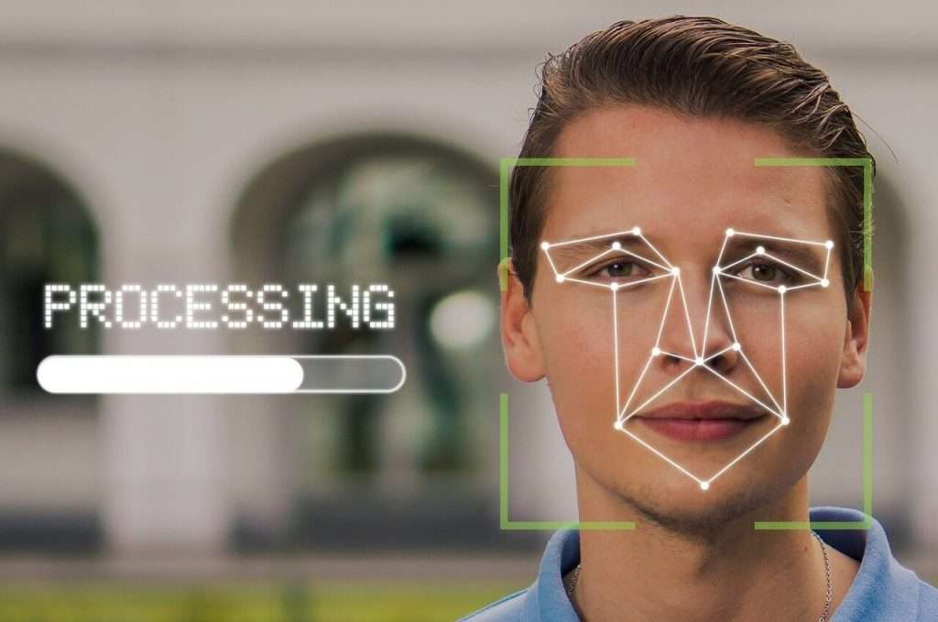
Objectives
image processing
video capture and analysis
face detection
object detection

Slide 6
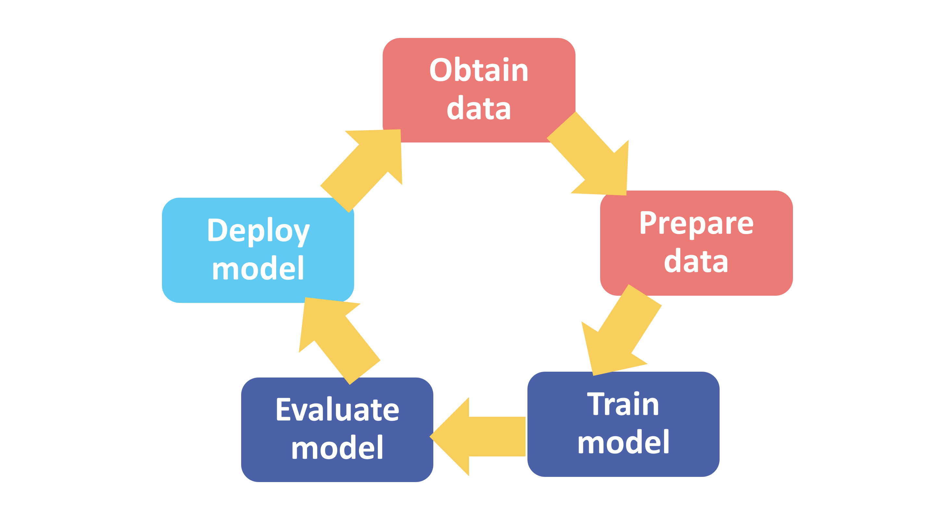
Overview Of Machine learning
Branch of artificial intelligence (AI)
Teaching computers to learn from data
large number of powerful libraries and frameworks
it easy to implement machine learning algorithms.

Slide 7
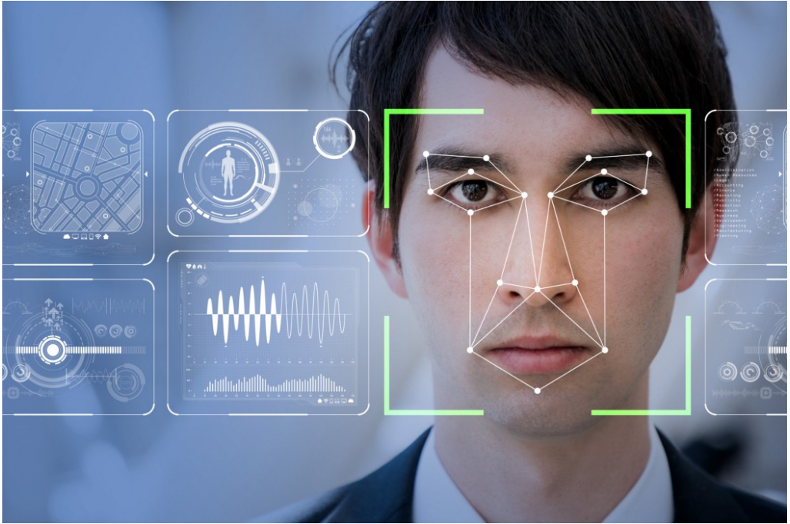
Face Detection
a computer program detects the presence of human faces
finds their locations

Slide 8
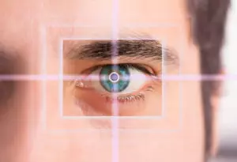
Eye Detection
Eye detection is a popular and useful operation in OpenCV.
It can be used in a variety of applications
use Haar cascades machine learning technique.
use self trained models in this process.

Slide 9

Real Time Face and Eye detection
Acquire Image from camera
Detect eye in face image
Convert colour to Gray-scale
Eye Detected?
Cascade classifier
Detect Faces
Show image with outline over face and eye
Face Detected?

Slide 10
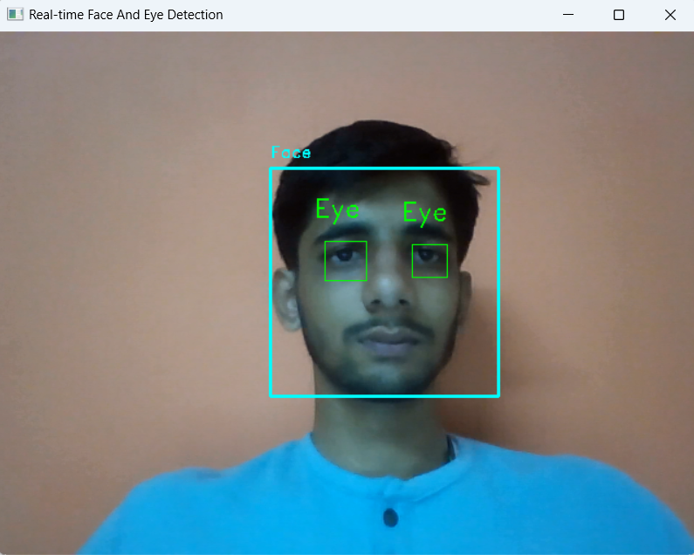
Real Time Implementation
Using Opencv
Using webcamera
Detect face and eye
Code Reference

Slide 11
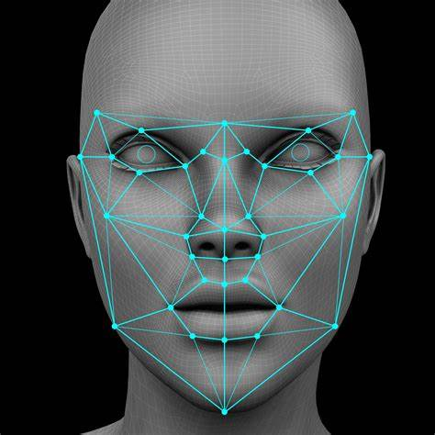
Conclusion & Future Aspects
long way and have a wide range of applications
need to improve their performance in unconstrained environments.
expect to see further advancements and improvements in the future.

Slide 12
THANK YOU

